Slide 1
System Modeling
Assessment & Roadmap WG
Overview and Status
Updated 10/6/14
Based on inputs from Austin Meetings
Austin, Texas
September 16, 2014
http://www.omgwiki.org/OMGSysML/doku.php?id=sysml-roadmap:sysml_assessment_and_roadmap_working_group
Sandy Friedenthal
Eldad Palachi

Slide 2
Topics
Background and Purpose
Preliminary Assessment Inputs
System Modeling Environment Conceptual Framework
Roadmap Approach

Slide 3
Working Group
Background
Background
  Previous SysML Roadmap discussion at Reston, March 2012 (refer to minutes-syseng-2012-03-02, and roadmap presentation-syseng-2012-03-07)
  Action item from Yves Bernard Roadmap presentation at Santa Clara SE DSIG in Dec 2013 to distill inputs and refine approach (refer to SE DSIG minutes-syseng/2013-12-01)
  Action from Reston meeting in March 2014 to establish Working Group to begin to develop roadmap

Slide 4
System Modeling
Assessment & Roadmap WG
Purpose
Assess effectiveness of system modeling with SysML in support of MBSE Adoption and Use
Develop a preliminary System Modeling Roadmap to improve effectiveness
Use the Roadmap to influence the SysML specification, tool vendor implementations, related standards efforts, and industry collaborations

Slide 5
Boston WG Meeting Agenda
June 2014
Introduction - Eldad/ Palachi/Sandy Friedenthal
  Meeting objectives, agenda
  Assessment purpose , scope , and evaluation criteria
Assessment & Preliminary Findings
  Previous SE DSIG inputs – Sandy Friedenthal
  UML for SE RFP report – Yves Bernard
  SysML RFI Summary and Findings – Rick Steiner
  MBSE Adoption Issues – Uwe Kaufmann
  MBSE Environment Challenges - Chris Delp
MBSE Use Cases – John Watson
Consolidate Prioritized Improvements - All
Plan Forward - All

Slide 6
Meeting Attendees
Yves Bernard - Airbus
Roger Burkhart – John Deere
Chris Delp - JPL
Michael Chonoles – ChangeVision
Sandy Friedenthal – SAF Consulting
Robert Karban - JPL
Uwe Kaufmann - ModelAlchemy
Len Levine – DoD/DISA
Eldad Palachi (call in) - IBM
Nicolas Rouquette - JPL
Rick Steiner (call in)
John Watson – Lockheed Martin

Slide 7
PRELIMINARY ASSESSMENT INPUTS

Slide 8
Systems Modeling Directions & Needs
Source: Derived from SE DSIG Minutes Dec 2011
Presented at SE DSIG Dec 2012 as part of Roadmap Discussion
Rich diagrammatic syntax with standard symbol libraries for domain specific applications (e.g. Visio libraries)
Extensive viewing capability to query the model and present the results. (e.g., similar to building architecture layers)
Extensive modeling checking and analysis capability to reason about the system model and confirm its integrity
Extensive reuse libraries

Slide 9
Systems Modeling Directions & Needs
Source: Derived from SE DSIG Minutes Dec 2011
Presented at SE DSIG Dec 2012 as part of Roadmap Discussion
Cross domain model integration through transformation technology and interchange standards
Scalable model management part of PLM to include configuration control , change management & workflow
Built in modeling metrics to effectively estimate productivity, quality, and risk

Slide 10
UML for SE RFP
Traceability Matrix Summary
Traceability matrix developed for original UML for SE RFP
Updated to reflect SysML v1.4
Use to identify potential gaps

Slide 11
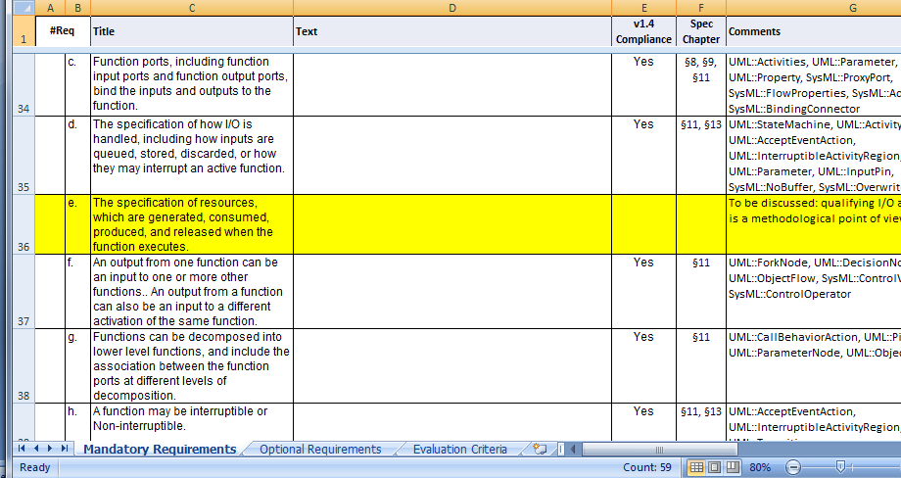
UML for SE RFP
Traceability Matrix Example

Slide 12
SysML RFI Summary (2009)
Web based survey
  Used SurveyMonkey.com web survey service
RFI Survey was open to any practitioner
  RFI Survey advertised using
    Introduced at INCOSE International Symposium MBSE sessions in Singapore
    Posted on two SysML forums (Yahoo, Google)
    Posted on two UML forums
    Several of the LinkedIn groups
    Large number of INCOSE members, including the MBSE list
    SE Domain Special Interest Group (SE DSIG)
    SysML Revision Task Force (RTF)
    OMG SysML Discussion Group
Survey consisted of two parts
  Part I – questions on SysML language
    Language effectiveness, issues, recommendations
  Part II – questions on how SysML is used to support a model-based systems engineering approach
    Methods, tools, training, metrics
Contact information obfuscated to protect individuals and companies

Slide 13
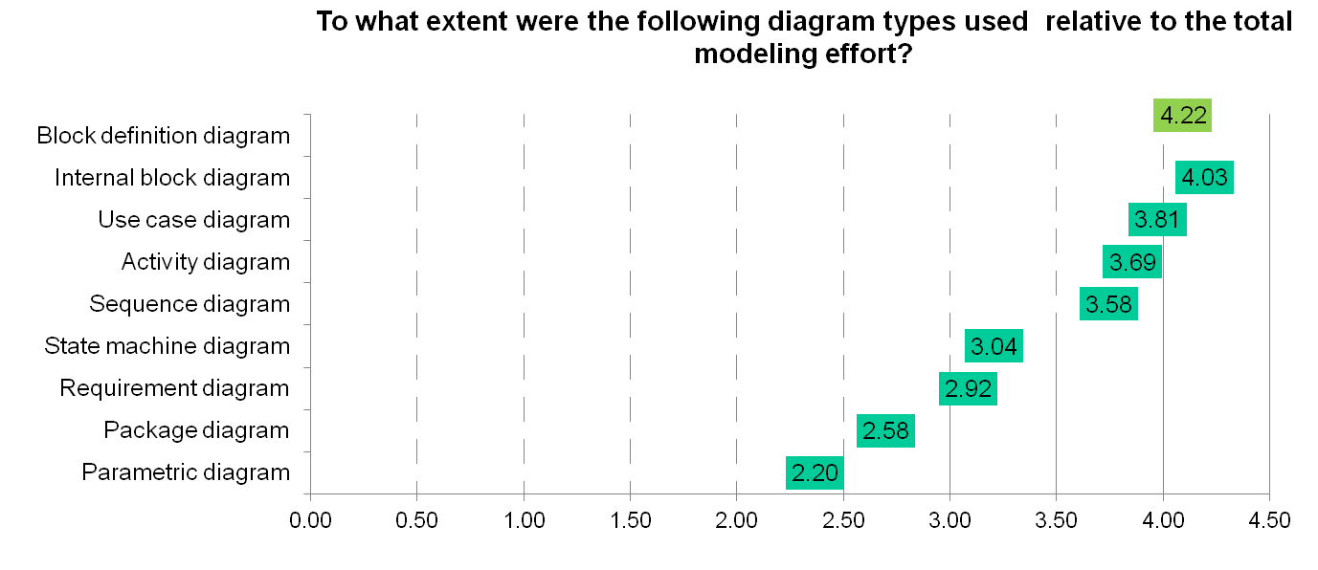
SysML RFI Example Result
Key Finding #11: BDD and IBD Diagrams
Block Definition Diagrams (BDD’s) and Internal Block Diagrams (IBD’s):
  Used the most
  Valued the most
  Hardest for stakeholders to understand
    Confusion on the use of ports and interfaces.

Slide 14
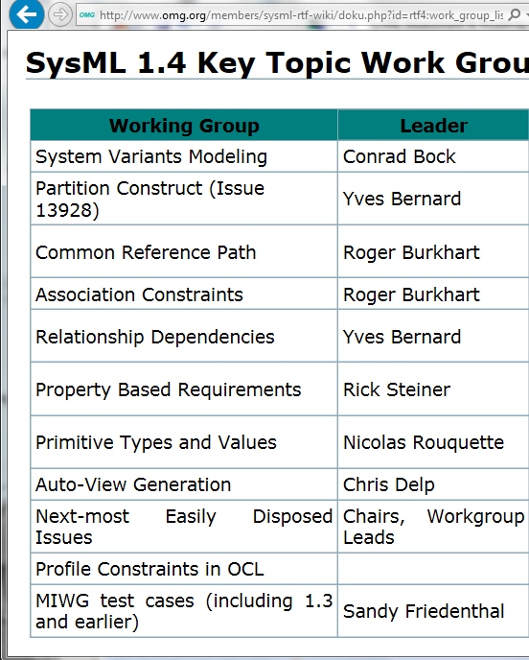
SysML v1.4 RTF Priorities

Slide 15

Previous SysML 1.4 RTF Priorities
 | Topic | Status | Comments
X | Variant modeling | Out of scope | The RTF declines to add specialized notation for variants
~ | SysML Formalization | SysML annex in the PSCS proposal
~ | Allocation concept (13840) | Some improvements made | Semantic issue still pending. Might implies an UML enhancement
~ | Instance modeling | Instance specification added in 1.3 | Some remaining issue about specification of individuals
0 | Property-Based requirement | No noticeable progress | Controversing
0 | SysML/MARTE convergence | No noticeable progress | WG no more active
0 | Timing Diagram | No work reported
0 | Conceptual Model of SysML | No work reported
~ | Simplifying Parametrics Diagrams | Prametrics improved in 1.4 | No clear requirement regarding « simplification »
X | Port/Parameter relation | Resolved in 1.4
X | Reference nested property (14055) | Resolved in 1.4
X | Element Group (13928) | Resolved in 1.4
0 | Parsing Text in Requirements (13939) | No work reported
~ | View/Viewpoint alignment with ISO 42010 | Veiw/viewpoint improvement in 1.4 | To be re-evaluated against the capabilities added
0 | Additional UML construct in UML4SysML | No work reported
0 | Item flows on sequence diagrams | No work reported
X | Align SysML with QUDV | Resolved in 1.4
X | Model lib for ISO80000 parts | Resolved in 1.4
X | Ambiguous block hierarchy (14447) | Resolved in 1.4
~ | Easily disposed issues | Improvments in 1.4 | No precise set defined
0 | Concepts from AUTOSAR (tech arch) | No work reported
0 | Alignment with UML Testing profile | No work reported
0 | HSUV example in SysML tool | No work reported
0 | Requirements interchange issue (13177) | No work reported
0 | Automatic test case generation | No work reported
0 | Datasets (13219) | No work reported
X | Standard alignment (URL, etc..) | Resolved in 1.4 (TBC) | Missing references to issues, if any
~ | Production issues | SVN available | Document production remains problematic
X | Constraining decomposition hierarchy | Resolved in 1.4
0 | Profile constraint | No noticeable progress
Higher
Lower
- Legend -
0: not started/stopped ~: in progress X: done X: aborted

Slide 16
MBSE Adoption Issues
Source: SE DSIG Minutes, December 2013
More focus on mechanical engineering
Provide more examples/guidance
Availability of libraries of reusable models
Availability of patterns
Language stability
Increased analysis capabilities
A clear value assessment from using SysML
Model consistency
Domain specific icons
Support for continuum of models that support early concepts and more detailed formal models

Slide 17
MBSE Adoption Issues (cont.)
Source: SE DSIG Minutes, December 2013
Agility of modeling
Dynamic (i.e. simulation) and static analysis capabilities
Capture of trade studies
Reduce the number of ways things can be modeled. This is a source of confusion to modelers
Ability to represent model in textual form
Better handling of large number of requirements
FMEA capabilities
Consider industries which are not highly regulated
Consider how to model humans
Make the model invisible (transparent) to support other discipline engineers
MDA for SysML

Slide 18
SYSTEM MODELING ENVIRONMENT
CONCEPTUAL FRAMEWORK

Slide 19
System Modeling Environment
Scope
Part of an MBE Environment that includes:
  SysML modeling language and tools (v1.4 ++)
  Modeling languages and tools that support use of SysML (e.g. constraint language, transformations)
  Integration technologies with other engineering models and tools
  Reuse libraries (e.g., system models, modeling practices)
Note: Clarify scope of analysis models

Slide 20
Systems Modeling Environment
Summary Evaluation Criteria
Derived from UML for SE RFP
Expressive
  Coverage of systems modeling concepts
  Extensible to other domain concepts
Precise
  Formal semantics (incl. execution of stm, act, par)
  Unambiguous
  Concise/Minimal/Parsimony
Model construction
  Efficient and intuitive model construction and update
Presentation
  Communicates effectively to diverse stakeholders
Interoperable
  Data exchange and transformation with other models and structured data
Manageable
  Can be efficiently managed (e.g., change/version mgmt)

Slide 21
Systems Modeling Environment
Summary Evaluation Criteria (cont)
Derived from UML for SE RFP
Usable (cross cuts other functionality)
  Ability to efficiently create and update model
  Ability to easily and flexibly present in different forms
  Model construction and presentation matches systems concepts
  Straightforward to learn
Adoption of System Modeling Environment (end users, vendors, ..)
  Value
  Implementation cost

Slide 22
Systems Modeling Environment
Summary Evaluation Criteria (cont)
Additional criteria
  Deployability to different platforms (e.g., model editing and visualization from mobile device)
  Extensibility
  Standardized System Modeling API

Slide 23
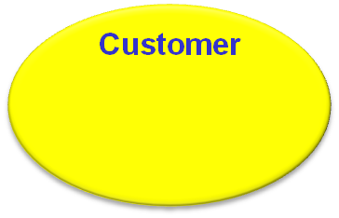














MBSE Use Cases
Product Support
Analytical Models
System Architectural Model
Verification Models
U
(
s
)
G
(
s
)
∫
Analysis Spec
Performance, RMA,
SWaP, Cost, etc.
System Engineering Development Environment
Manufacturing
Mechanical &
Electrical Models
Software Models
S
SET
Q
R
CLR
Q
To measure SysML effectiveness we need to understand the context of how it is used
Source: John Watson
© 2014 Lockheed Martin Corporation. All Rights Reserved.

Slide 24
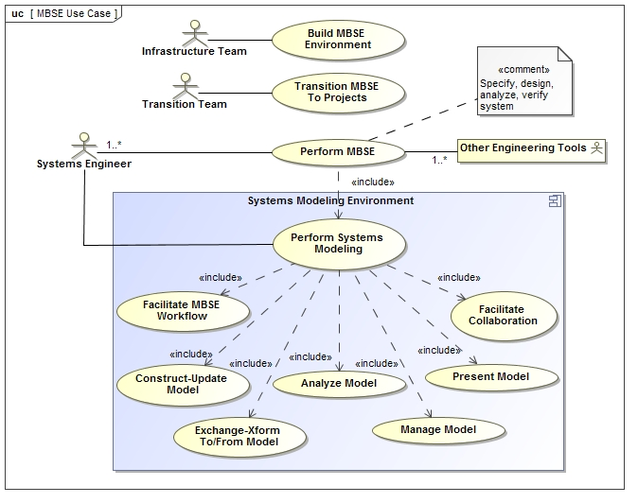
System Modeling Environment
Basic Functionality in Support of MBSE
9/19/14

Slide 25
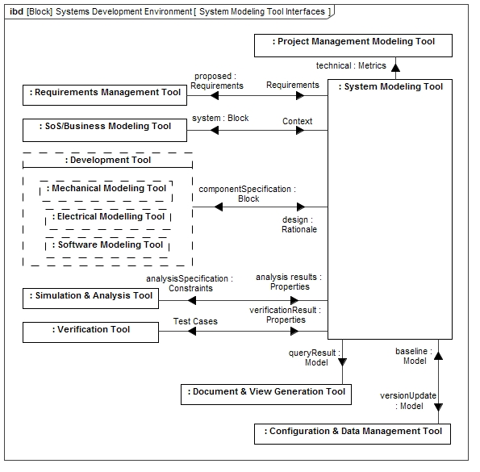

Systems Modeling Environment
Source: A Practical Guide to SysML, 3rd Edition
Figure 18.5. High level information exchange between the system modeling tool and other tools.

Slide 26
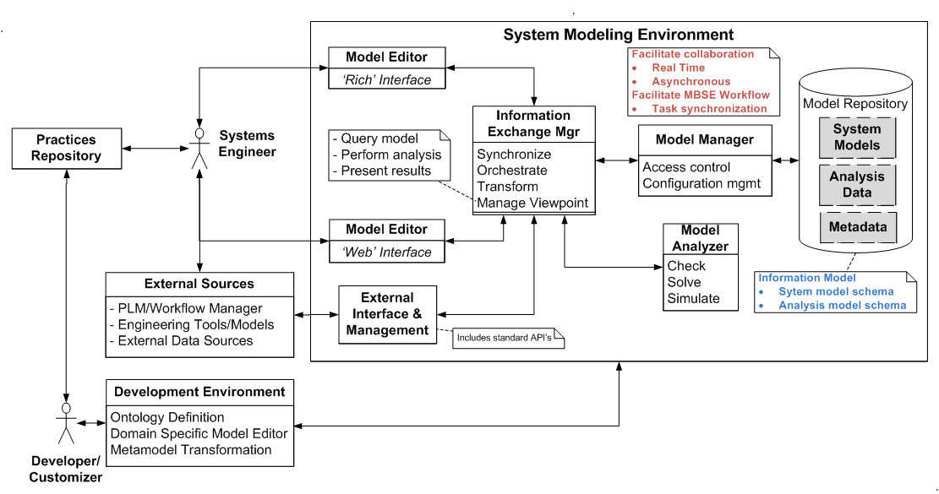
Systems Modeling Environment
Conceptual Architecture
10/06/14

Slide 27
ROADMAP APPROACH

Slide 28
Systems Modeling Environment Roadmap Approach
Support for MBSE
  Develop and evolve cross-discipline MBSE Use Cases and supporting Modeling Patterns to help derive requirements for how System Modeling Environment is used across lifecycle
  Capture MBSE value proposition over traditional approach (e.g., improvements in quality, productivity, …)
Expression
  Develop System Concept Model based on SysML v1.4 profile and original UML for SE RFP concept model to refine requirements and system concepts that the language must express
Presentation/Visualization/Communications
  Develop the use cases and concepts for how to present, visualize, and communicate the system concepts to accommodate a diverse set of uses
    Dynamically generated 3D graphs, analytic (e.g. response surfaces), and geometric/spatial presentations coupled with animation and tabular and textual presentations

Slide 29
Systems Modeling Environment Roadmap Approach (cont)
Model Construction
  Develop the use cases and concept for how to construct and update the model and views in an efficient and intuitive manner
    Rule-based and manual construction
    Intuitive patterns such as composition hierarchies & relationships
    Efficient search and navigation techniques
    Reuse libraries
    Rapid model population from external sources
    Model updates from outside tool (e.g., web browsers)
Model Analysis
  Develop the use cases and concept for how to analyze the model in an efficient and intuitive manner
    Identify analysis to be performed such as well-formedness, design integrity, completeness, consistency, traceability, change impact
    Determine how to effectively query, operate, & report results

Slide 30
Systems Modeling Environment Roadmap Approach (cont)
Model Interoperability
  Develop the use cases and concept for linked data to integrate the system model with other engineering models and tools (e.g., CAD/CAE, software design, analysis, verification, mgm’t)
    Leverage OSLC, JPL MBEE, SLIM, PLM, Model Center
    Enable linkage to non-model based artifacts
    Define efficient transformation/mapping mechanisms to/from model
Model Management
  Develop the use cases and concept for efficient, flexible, and lightweight versioning and change management concepts (e.g., diff) throughout system lifecycle (e.g., github), & workflow integration
Usability
  Develop concepts that minimize learning time and maximize overall effectiveness for using the system modeling environment to construct models, analyze models, present models, exchange models, and manage the model across the life cycle

Slide 31
Systems Modeling Environment Roadmap Approach (cont)
MBSE Workflow
  Develop the use cases and concepts for managing MBSE workflow
    Task notification
    Model to task association
Collaboration
  Develop the use cases and concepts for managing collaboration with System Modeling Environment
    Subscription notification of changes
    Real time interaction

Slide 32
Systems Modeling Environment Roadmap Approach (cont)
For each capability area identified on the previous 3 slides
  Assess the current state to identify capabilities and limitations
  Develop the concept and requirements and refine the moe’s that reflects the vision for how this can and should be done in the future
  Determine near term, mid term, and long term improvements that can be realized
    Identify and leverage current activities , research, and initiatives where practical
  Develop a follow-up plan on how to move forward
Integrate the concepts from each task area into an overall system modeling environment concept and roadmap that supports MBSE in the context of Virtual Engineering

Slide 33
Systems Modeling Environment Roadmap Summary
Develop MBSE Use Cases
Update System Concept Model
Assess current state and develop concepts and requirements for each capability area
  Model Construction
  Model Visualization
  Model Analysis
  Model Interoperability
  Model Management
  Workflow Management
  Collaboration Management
Evolve system modeling environment
  Requirements, concepts, and prototype implementations
  Implementation plans for near term, mid term, long term
    RTF, RFI’s, RFP’s

Slide 34
Systems Modeling Environment Roadmap Summary
Develop MBSE Use Cases – John Watson
Update System Concept Model – Robert Karban/Maged Elaasar
Assess current state and develop concepts and requirements for each capability area
  Model Construction
  Model Visualization
  Model Analysis – Manas Bajaj
  Model Interoperability – Axel Reichwein
  Model Management – Amit Fisher
  Workflow Management
  Collaboration Management
Evolve system modeling environment
  Requirements, concepts, and prototype implementations
  Implementation plans for near term, mid term, long term
    RTF, RFI’s, RFP’s

Slide 35
PREVIOUS VERSION

Slide 36
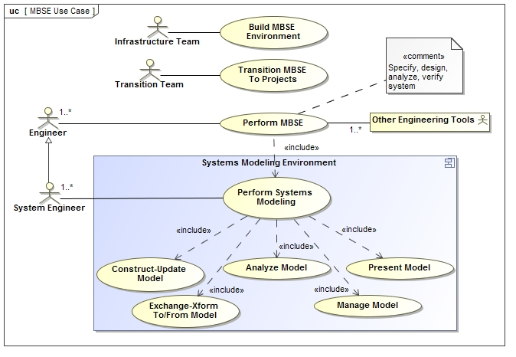
System Modeling Environment
Basic Functionality in Support of MBSE

Slide 37
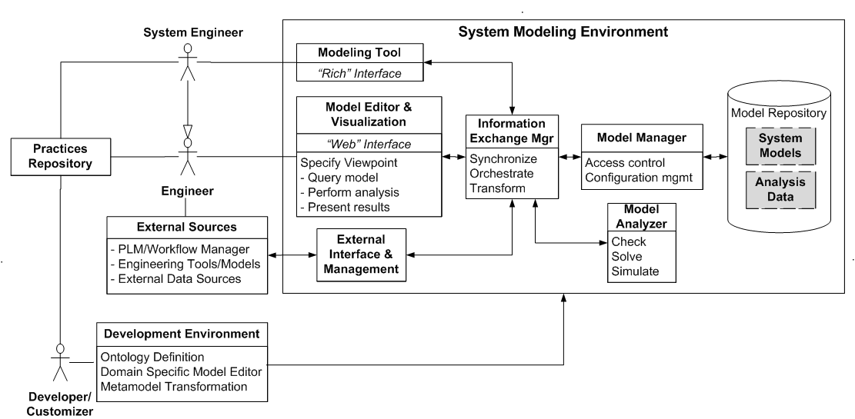
Systems Modeling Environment
Conceptual Architecture
9/11/14

